Slide 1
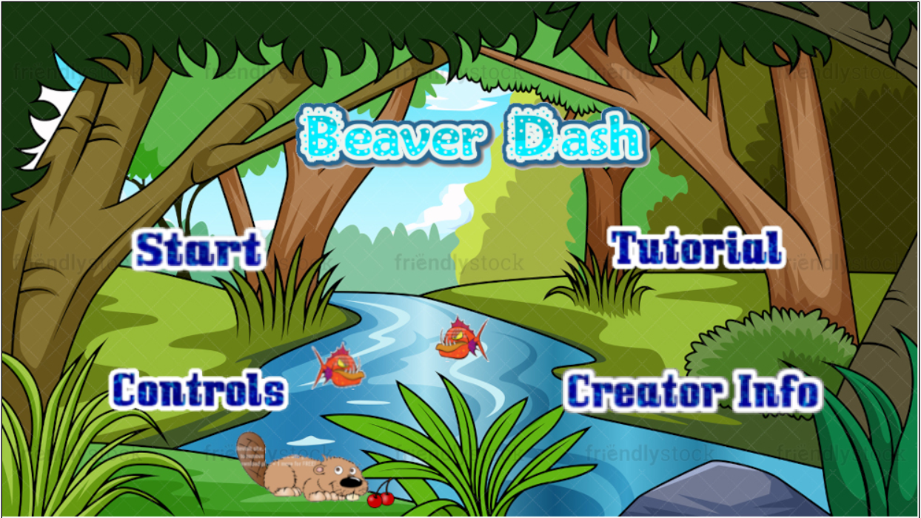
Beaver Dash
Nathaniel Bridgman, Natan Lellouche, Kyle Husbands

Slide 2

Game Description
The world is in a forest. There is a 2D river winding around the screen. The river’s edges are lined with stones.
The game is a beaver swimming down a river, dodging obstacles along the path. The obstacles include wooden logs, piranhas, and whirlpools blocking the path.
The beaver is moving in the river at a constant velocity. The user uses the arrow keys to move.
Along the way there will be berries that the user can collect. The berries will be worth points, and will contribute towards the player’s high score, The high score will accumulate over the 3 levels.
The goal of the game is to reach the end of the river without dying, where there is the beaver’s home, a dam.

Slide 3
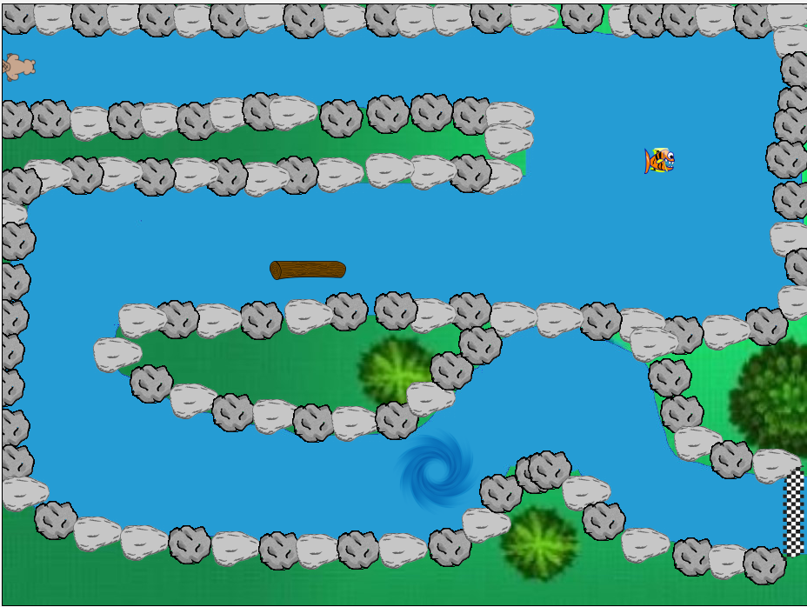
Tutorial
First we created a background image that consists of a green layer, a couple trees, and then we drew the river.
We then lined the river with stones and rocks, placed the beaver, the log, the piranha, the whirlpool, and the finish line.

Slide 4
Level One
We created a second background image with a different river on it.
We then lined the new river with stones and rocks, and then placed the beaver and the finish line.
In the first level, we wanted there to only be logs as obstacles, and as the levels progressed we would introduce more obstacles.
If a beaver touches a log that is floating on the river, the player will have to restart from the beginning of the level that they are currently on
We also included a red cherry and a golden cherry in two different hard-to-get locations, to entice the user to play a little more dangerously.

Slide 5
Level Two
We created a new river for Level Two.
Again, we put rocks and stones at the edges of the river, but this time we included logs and piranhas as the obstacles for Level Two.
Piranhas move along the width of the river, waiting to eat the beaver. If the beaver touches the piranha, the user will restart from the beginning of the level they are currently playing on.
Finally, we placed three cherries, one red cherry and one gold cherry, in different spots to contribute to the player’s high score.

Slide 6

Level Three
For the last level, we included all 3 kinds of obstacles along the beaver’s path; Logs, Piranhas and Whirlpools.
While the beaver is on a Whirlpool, the right and left arrow keys are inverted, making it harder for the beaver to maneuver and travel around bends in the river.
There are two cherries on level 3, one of each kind, to give the player a secondary goal of getting a high score.

Slide 7


Challenges
The Physics:
Adjusting the speed of the beaver
Adjusting the speed of the piranha
The degree at which the beaver turns
Placing the whirlpool so as to not make the game too hard but also challenging
Adjusting the width of the river to allow room for movement
Putting the game together:
Putting each individual level into one Greenfoot project
Readjusting the names of each class (each team member had named their classes and worlds something different)
Task and Time Management:
Distributing tasks evenly
Many tasks that needed completing sometimes needed pieces from other group members in order to continue
Staying on schedule

Slide 8

Future Enhancements
More Complex Level Design:
Bigger Screen to work with
Longer Rivers and Levels
Checkpoints
New obstacles
Screen/view moves as well
More Levels

Slide 9
Task Breakdown
Nathaniel:
Tutorial
Level 1
Beaver Code
Rocks, Stones and Logs
PowerPoint Slides
Kyle:
Level 2
Piranha code
Berries and High Score System
Game Won Screen
Game Menu
Putting the game together
Natan:
Level 3
Whirlpool Code
Game Over Screen
Music and Sound Editing

Slide 10
References
Pictures:
Pixabay.com
Unsplash.com
iconmonstr.com
Pexels.com
Dreamstime.com
Inspiration:
The World’s Hardest Game
Temple Run
Music and Sounds:
Opengameart.org
zapsplat.com

Slide 11
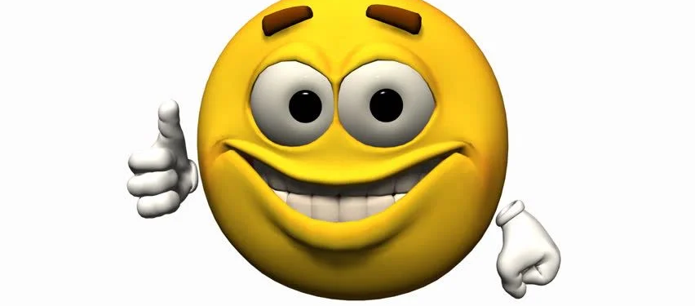
THANK YOU

